Slide 1
Zoom Best Practices

Slide 2
Announcements
This afternoon (June 30), at 1:30pm CST we will be hosting a hands-on Makerspace Play Space event.
This event will have a different Zoom link.
Please visit our Google Calendar for all our events and Zoom links: https://languagetech.lab.uiowa.edu/ Click the “Events” tab to see the Google Calendar.
A link to our Google Calendar will also be placed in the chat.
Tomorrow (July 1), at 1:30pm CST, we will be hosting our rescheduled Faculty Panel.

Slide 3
Goals For Today
General
Best Practices
Etiquette

Slide 4
Zoom: General Tips

Slide 5
Zoom: General
Download the app
Login with SSO
Check your meeting settings at uiowa.zoom.us
Know your meeting
How Zoom works
Zoom creates a meeting ID number/URL link to a video meeting using Zoom software
3 meeting types

Slide 6
Zoom: General
3 meeting types
Scheduled meetings
Creates a different meeting ID/URL link every time you schedule a meeting
Expires after the scheduled time
Recurring meetings
Creates a different meeting ID/URL link for each recurring meeting
Allows the use of the same meeting ID/URL link for up to 365 days after you schedule it/create it
Personal Meeting ID
A meeting ID/URL link that is specific to your username and never expires
Best not share it in a public forum

Slide 7
Zoom: General
Zoom Webinars (need license)
Different format, no participant videos
ITS has a limited pool of general Zoom Webinar licenses available for checkout
Your department can get a Zoom Webinar license to share between the members of your department (perhaps even the LMC could look at getting some Zoom Webinar checkout licenses)

Slide 8
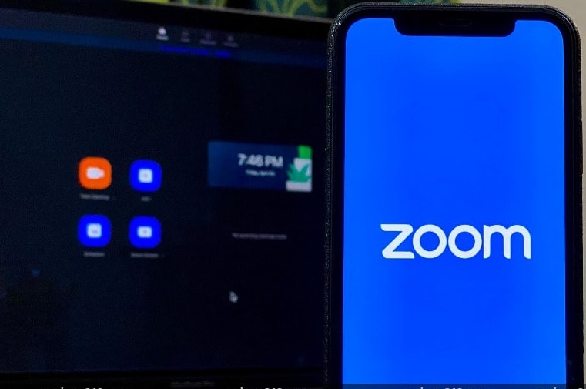
Zoom Etiquette: You As a Participant

Slide 9
Zoom: Etiquette
AS A PARTICIPANT
Log into Zoom Prior to Meeting Time
Get settled/set up
Realize if you’re in a Zoom Waiting Room
Mute your microphone
To help keep background noise to a minimum, make sure you mute your microphone when you are not speaking

Slide 10
Zoom: Etiquette
AS A PARTICIPANT
Check Video Background
How you present yourself is important
Your background could possibly affect others (Example: vestibular sensitivity from ceiling/fans)
Position your camera properly
Turning your video off is always an option
Just be aware and be professional
People can see you
Sometimes meetings are recorded

Slide 11
Zoom: Etiquette
AS A PARTICIPANT
Use two screens, if needed
Logging in on two separate devices allows you more access to what you want to see
Make sure to keep audio and video OFF on second device
Limit distractions
Avoid multi-tasking
Request to Speak
Using Non-Verbal feedback in Zoom

Slide 12
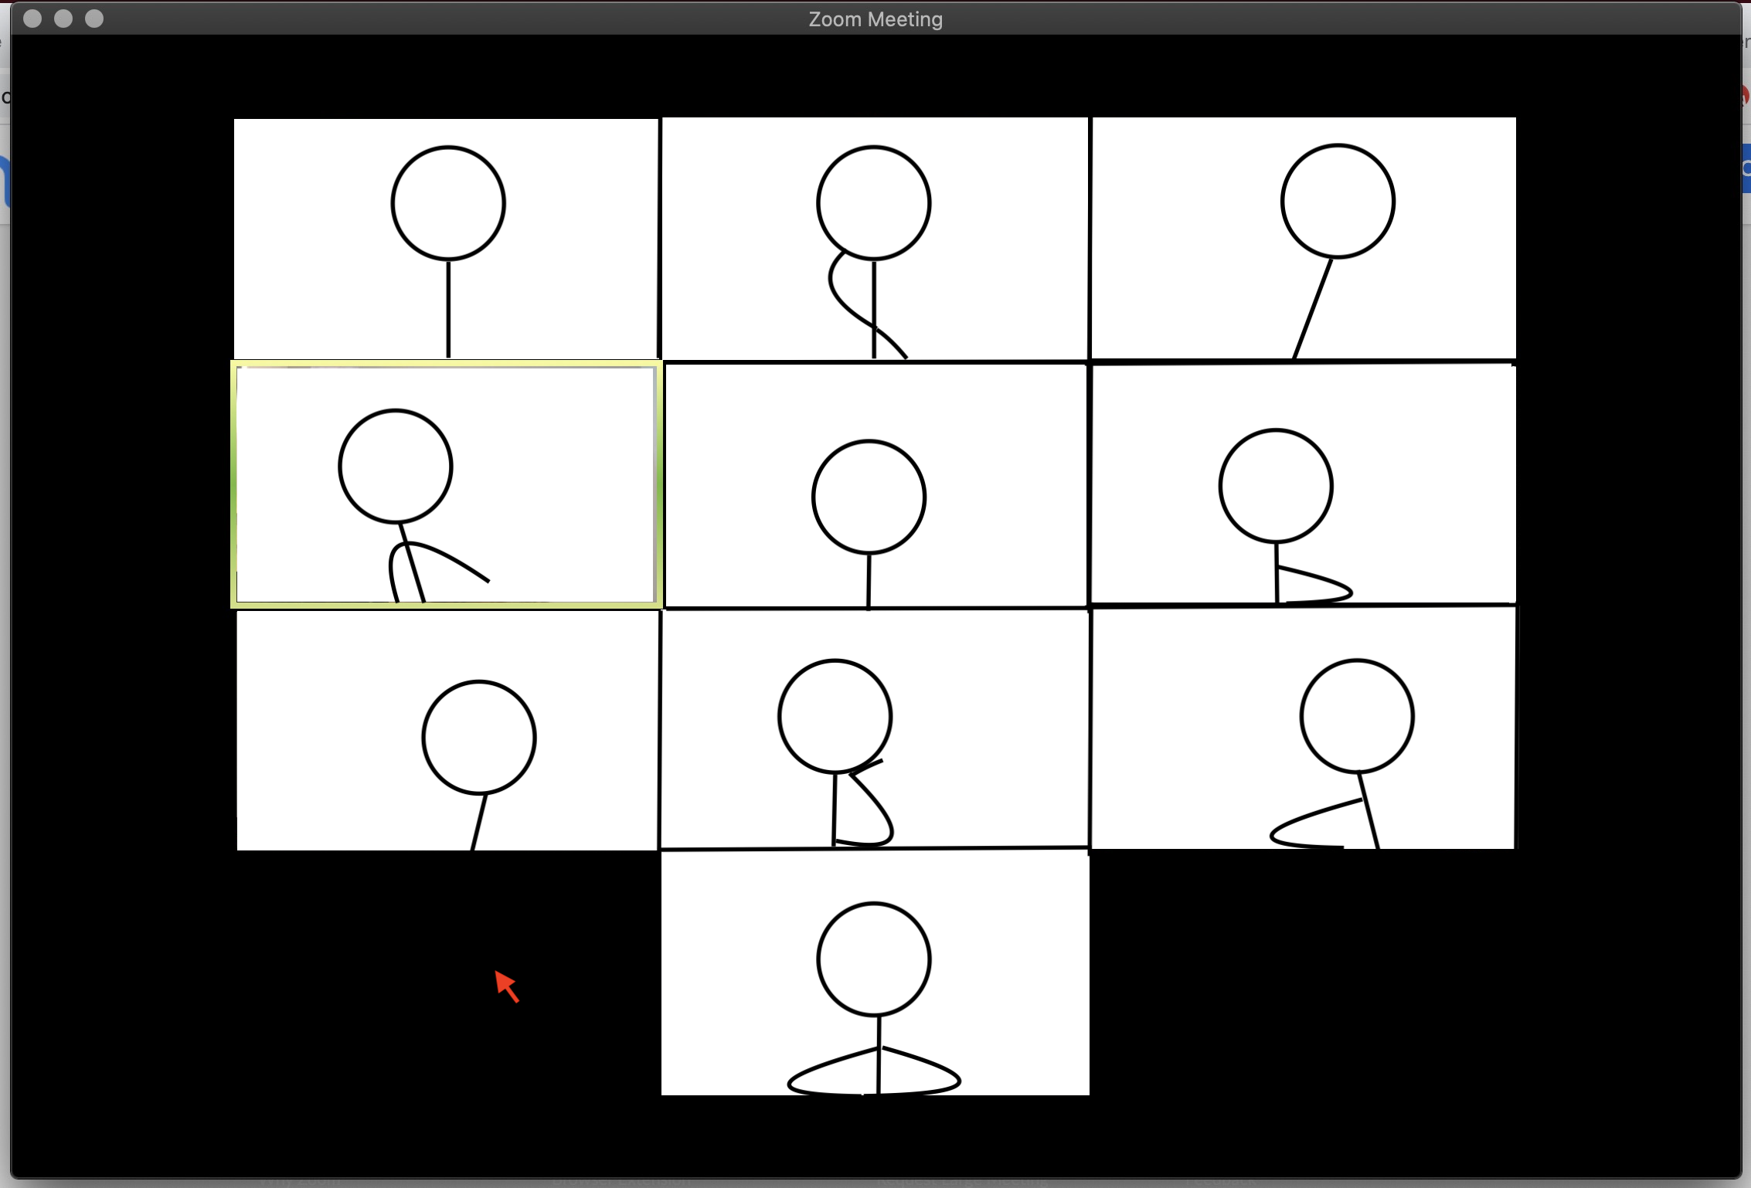
Zoom Best Practices: You As a Host

Slide 13
Zoom: Best Practices
AS A HOST
Log into Zoom Prior to Meeting Time
Folks can set up their headsets, camera and microphones
Turning off the setting "Join before host”/Turn on “Waiting Room” feature
Take Steps to Avoid Unwanted Intrustion/"Zoombombing"
Consider adding Authentication, a Waiting Room, or Password Protection when scheduling your Zoom meeting for security
Zoom Meeting Privacy Options

Slide 14
Zoom: Best Practices
AS A HOST
Prepare materials in advance
Screen & Video Sharing
Let participants know if this is allowed
Check the seetings for sharing your screen in Zoom
Be aware of what you’re sharing
Text Chat Rules
Set ground rules for use of text chat

Slide 15
Zoom: Best Practices
AS A HOST
Allow only signed-in users to join
This feature can be useful when you want to control your guest list and invite only certain individuals
Lock the meeting
Locking a Zoom meeting that is in progress prevents new participants from joining, even if they have the meeting ID and password (if you have required one)
Set a meeting password
This option requires attendees to enter a password that you provide before they can join the meeting

Slide 16
Zoom: Best Practices
AS A HOST
Turn off annotation
You and your attendees can doodle and mark up content together using annotations during screen share
Disable private chat
Zoom has in-meeting chat for everyone, or participants can message each other privately
Disable video
As a meeting host, you can turn off someone’s video

Slide 17
Zoom: Best Practices
AS A HOST
Mute participants
You can mute/unmute individual participants or all participants at once
Turn off file transfer
In-meeting file transfer allows people to share files through the in-meeting chat
Monitor the chat
Take a minute to monitor what is happening in the in-meeting chat

Slide 18
Zoom: RESOURCES
Resources for Zoom teaching tips/best practices:
25 Strategies to Engage Students on Your Next Zoom Meeting
Turns Out You Can Build Community in a Zoom Classroom
Zoom 101 for Teachers
8 Ways to Be More Inclusive in Your Zoom Teaching
Active Learning for Your Online Classroom: Five Strategies Using Zoom
Why We’re Exhausted by Zoom (this one is less a tip, more interesting opinion)

Slide 19
QUESTIONS??
If you would like to go through your Zoom settings, Have specific issues or Questions, or want practice with settings, Please schedule a One-on-one with us!

Slide 20
We Are Here for you!
Lauren Kelley (Me)
lauren-kelley@uiowa.edu
Claire Frances
claire-frances@uiowa.edu
Nicole Metzger
nicole-metzger@uiowa.edu
Braeden Jones
braeden-jones@uiowa.edu

