Slide 1
Example of a warm-up activity

Slide 2
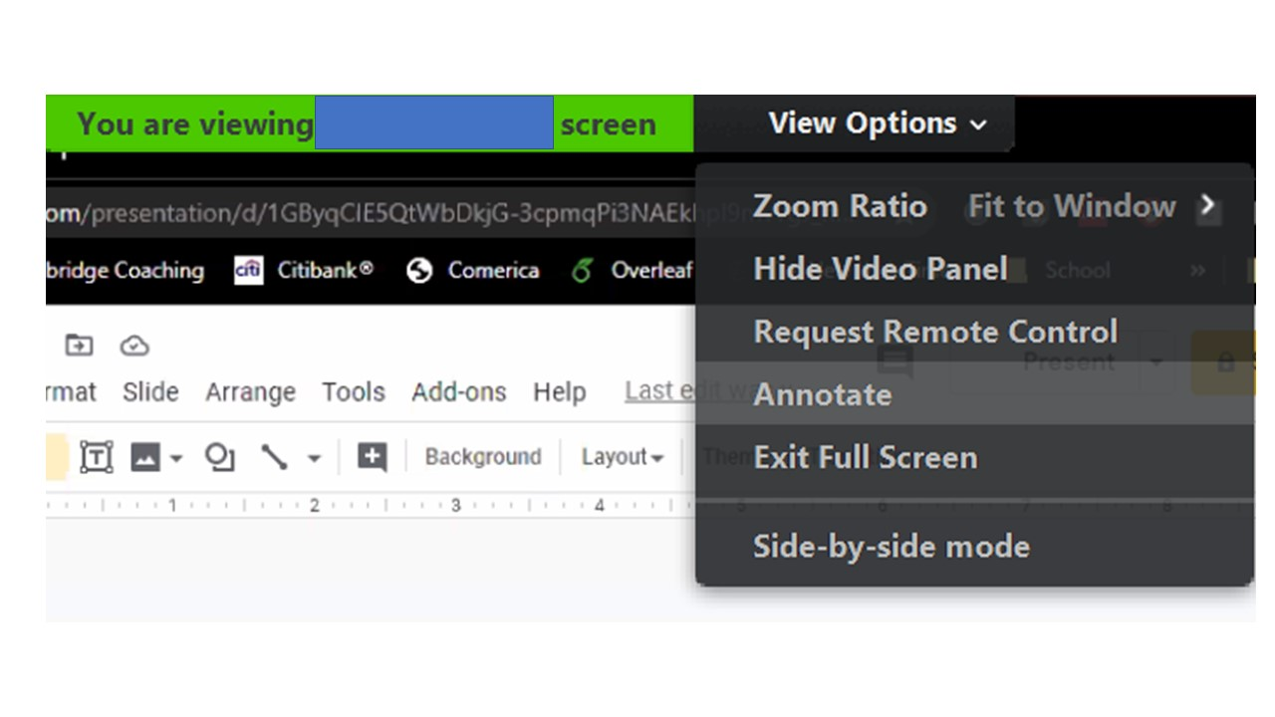
How to turn Annotate on

Slide 3
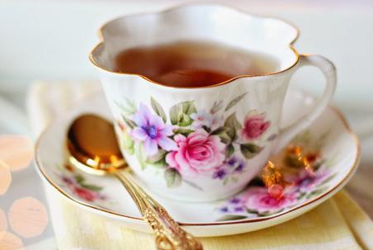
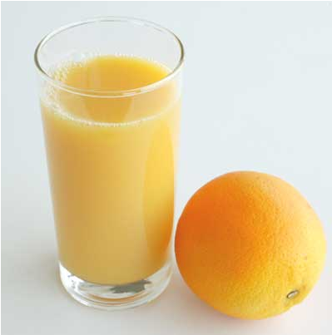
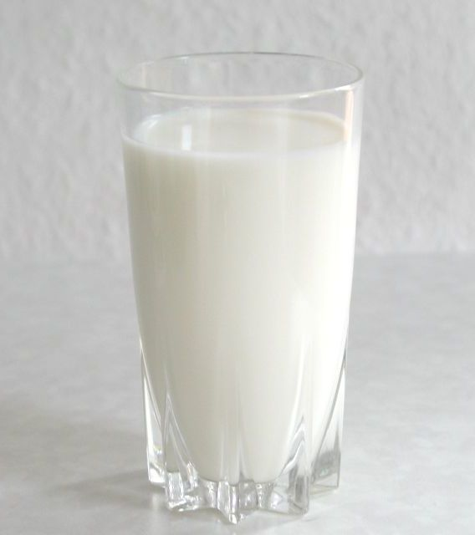
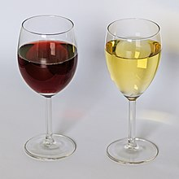
Name one drink that you had today
coffee
tea
juice
milk
wine

Slide 4
Who had what?
…
…
…
coffee
tea
…
…
…
juice
milk
wine

Slide 5
Who had what?
…
…
…
coffee
tea
…
…
…
juice
milk
wine

Slide 6
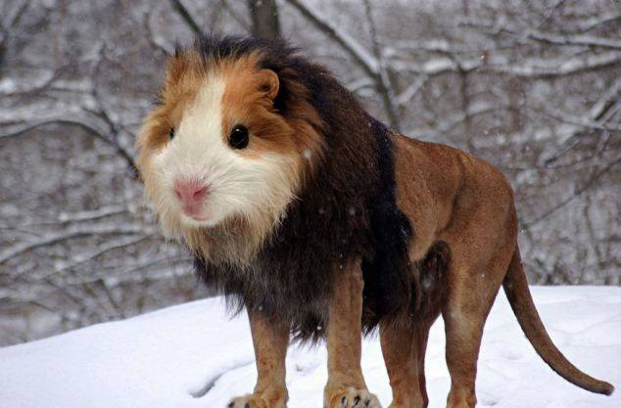
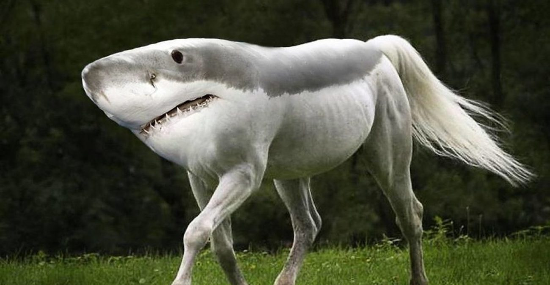
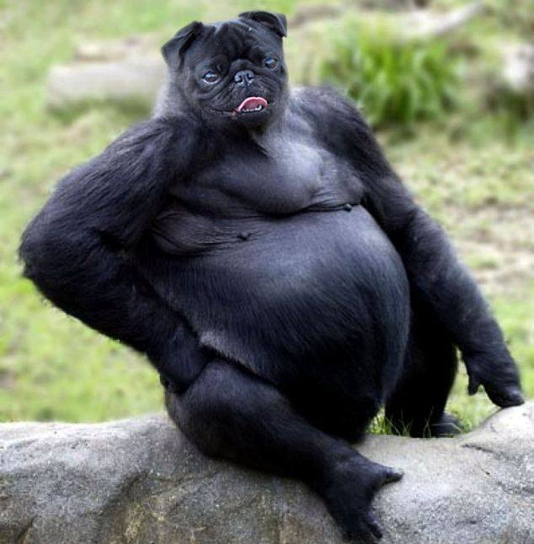
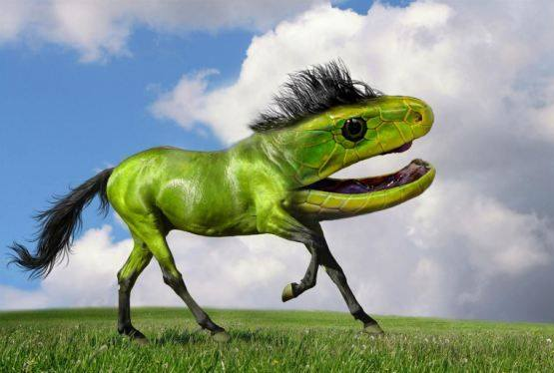
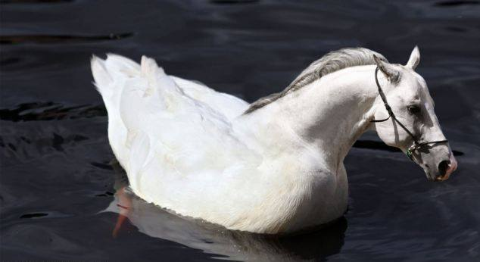
Come up with names for these animals

Slide 7
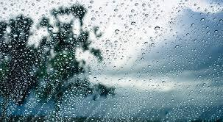
Last time it rained, I …..

