Slide 1
UICapture/panopto workshop

Slide 2
Goals for today
UICapture/Panopto Basics
Settings and Editing
Making a UICapture Quiz

Slide 3
Here is where you can start making content.
Here is where you find Panopto in your ICON course site.

Slide 4
Hit the arrow to see your video creation options within ICON.

Slide 5
Option 1 is to create a new session.
This allows you to open the Panopto App and start recording.

Slide 6
Clicking "Record a New Session" prompts a screen to open Panopto or download the app.

Slide 8
Option 2 is to upload existing media.
This allows you to add a video you've already recorded.
This is single media to build on, like for making a quiz (more on that later).

Slide 9
Clicking "upload media" prompts a screen to show you guidelines for acceptable use and captioning....

Slide 10
...and if you scroll down, you will see the area to click to add media or video files that already exist on your computer...

Slide 11
...once you click in the box, you should be able to choose a file from your computer, or you can drag and drop the file into the box.

Slide 12
Option 3 allows you to create a playlist of the videos in your Panopto account.

Slide 13
...the screen that prompts from the "playlist" option would look like this.

Slide 14
When you name the Playlist and click "create", this screen prompts you to add videos.

Slide 15
When you click "+Add Videos" a list of your exsiting content sorted by folder allows you to choose which content you want to add to the playlist.
You can add from multiple folders.

Slide 16
When you have made your choices, click "Add" at the bottom, it will tell you they were added.

Slide 17
When you click "close" on the previous screen, it will show you the playlist overview—you can edit here.

Slide 18
Your homepage will now show the playlist.

Slide 19
Option 4 allows you to make a new folder for your videos.

Slide 20
...the screen that prompts from the "new folder" option would look like this.

Slide 21
Click this button to go to your homepage on Panopto.com for more options!

Slide 22
Your homepage on Panopto.com will look like this.

Slide 23
Click the arrow on this page for more upload options!

Slide 24
These two options are the same as the page within ICON.

Slide 25
This option creates a "webcast" which is similar in concept to a Zoom webinar.
This is like a "live" Panopto recording.
It is a bit complicated, please come to our MakersSpace event or schedule a session with one of us if you'd like to know more.

Slide 26
This option allows you to upload separate video or presentation files that you created outside of any Panopto recordings and place them into a Panopto format.

Slide 27
Name your video project.
Choose a folder.
Hit "Create".

Slide 28
Click inside the box or drag and drop your primary video here (the video of you lecturing).

Slide 29
You can see my primary video is uploading.
And you can add another primary video feed.
OR you can drop in your PowerPoint.

Slide 30
Now you can see my PowerPoint is processing.
And my primary video is still uploading.

Slide 31
My PowerPoint slides have finished.
My video is still processing.

Slide 32
Both the video and the slides are done uploading, let's take a look at how to insert my slides into my video.

Slide 34
Now my Folder includes this Panopto video of the "session" I built.
This is only necessary to do if you have media that you don't want to re-record in Panopto.
If you haven't created any lectures yet, it would be much easier to control the slide progression while you are recording like we did in the "Record a New Session" option.

Slide 35
This is what the Panopto session looks like in "non-edit" format.
You can see when the slides come in.

Slide 36
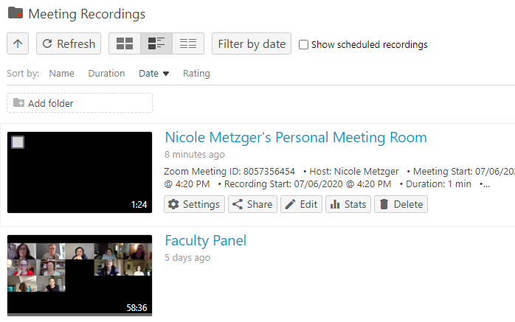
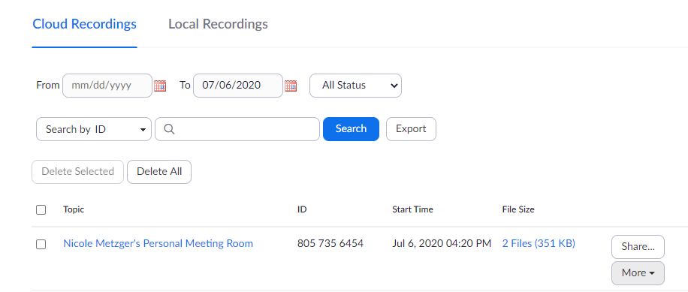
***Additional Note
Zoom anD UICAPTURE
It's important to note that any of your Zoom sessions that are recorded to the cloud, will end up in your Panopto account AND Zoom.
If you want a pinned person to show up on your recording you MUST record to your computer.

Slide 37
Settings and Editing
Making a UICapture Quiz

Slide 39
concierge service in the LMC
Claire-frances@uiowa.edu
Nicole-metzger@uiowa.edu
Lauren-kelley@uiowa.edu
Braeden-jones@uiowa.edu

Slide 40
What's next this week?
Tuesday
1:30PM, Makerspace Play Place: Come ask us questions or play around with new technology!
Wednesday
10:00AM, Prezi
Thursday
1:30PM, Podcasting

