Slide 1
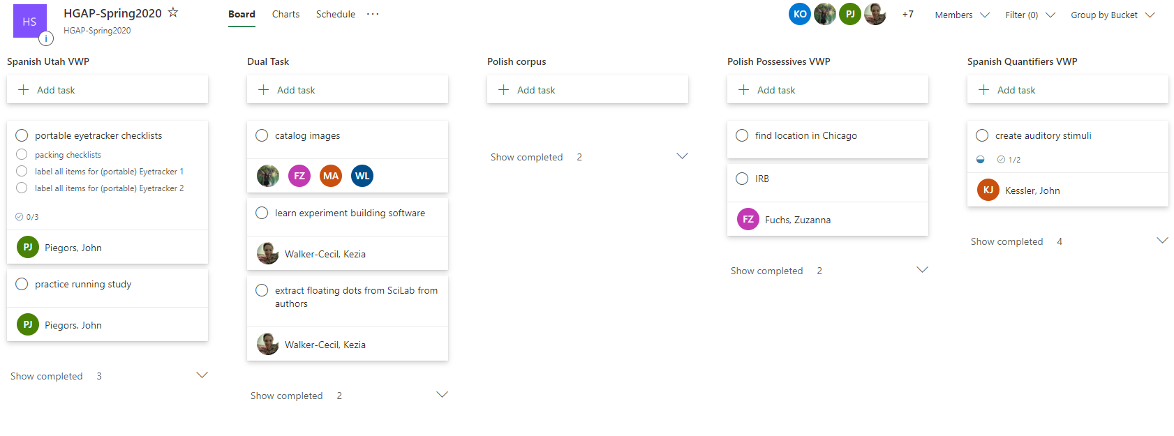
For collaboration: Outlook groups

Slide 2
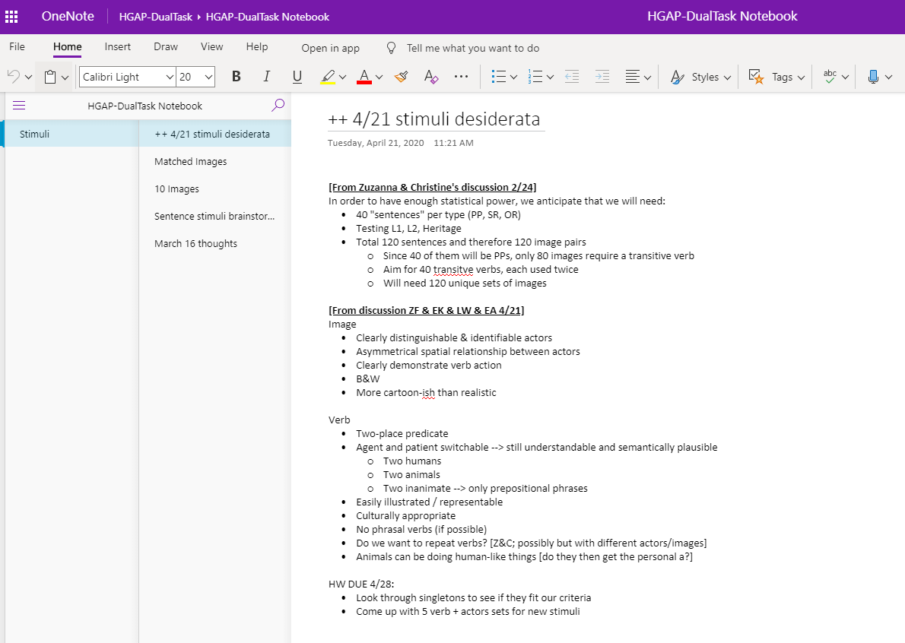
For collaboration: Outlook groups

Slide 3
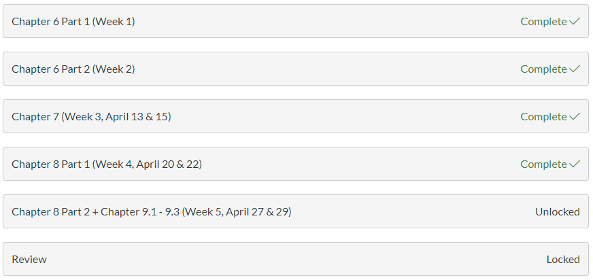
A fostering-community-fail: group work
Doing this successfully probably requires very thoughtful consideration how whether deadlines are spaced out in such a way that students are likely to be roughly in the same place in the course...…

Slide 4
Fostering community:
What I achieved/completed from last week
(Can include personal matters, can be academic unrelated to our lab)
What my goals for this week are
What are my internal / external blocks

Slide 5
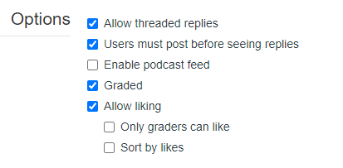
Favorite ICON tool: discussion boards
Students felt comfortable asking questions
Very specific ways of engaging with others’ posts
Mini “like” competitions
How to get more original posts:

