Slide 1
Course Design workshop

Slide 2
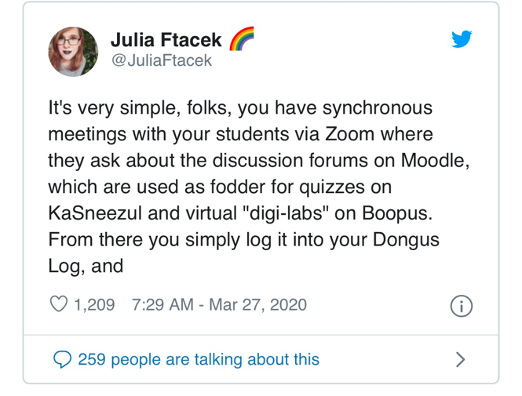

Slide 3
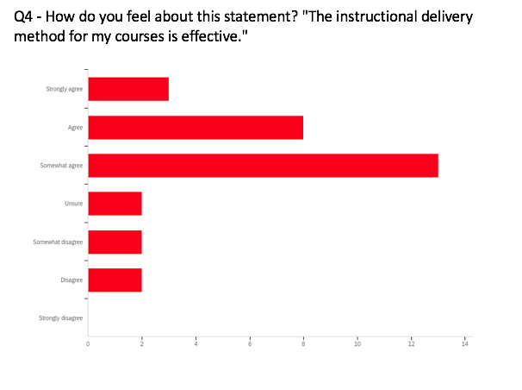

Slide 4
Goals for today
What is hy-flex?
An introduction to modular course design
Backwards design

Slide 5
WHAT is hy-flex course design?
Combines face-to-face with online learning. Students can choose to attend classroom sessions, participate solely online, or do both.

Slide 6
Blended modality
If classrooms are equipped with cameras, teaching stays very much the same as with full F2F
Need to provide content in asynchronous online modules as well

Slide 7
Online synchronous
Content:
Streamed live from the classroom using cameras and microphones.
ICON for information, resources, and assessment
Students share video and audio from their remote location with class
Interaction opportunities include online polls, interactive discussions, and group discussion.
Formal assessments = identical to that for classroom students.
Informal assessment = instructor must use tech to determine the synchronous students’ learning state (confusion? clarity? distraction?)
Assessment:
Engagement:

Slide 8
Online asynchronous
Content:
Delivered in the LMS.
Use multiple modes –text, video, audio, or student-generated content (e.g., discussion posts or video)
Opportunities for students to interact with content, instructor, and other students.
Common mode of engagement = discussion forum (need good topics/tasks and management/facilitation of discussions)
Formally graded assignments = same as classroom students
Use ICON tools (e.g., keeping on top of posts, regular check-ins, clarify student questions, engage students in self-assessment)
Assessment:
Engagement:

Slide 9
Modular course design
What is a module?
A "bucket of content used to organize course components"
What are the affordances?
Flexibility (e.g. if a course starts F2F, can easily move online "should circumstances warrant")
Easier to revise and improve (than an entire course)
Reusability (across courses)
Where can I learn more?
June 2nd at 10:30, led by our own Braeden Jones, as part of this series

Slide 10
components
Objectives + overview
Readings & other information sources
Lecture notes, powerpoints, websites, textbook chapter(s), articles, graphics, videos, etc.
Practice, application, analysis
Discussions, assignments, group activities, sharing of information, creative efforts, etc.
Assessment
Tests, quizzes, written assignments, debates, creations, demonstrations, peer observations, E-Portfolio, etc.
Feedback
Identifies progression toward module goals, grading of assessment tasks, etc. (self-assessment)
Purpose + expected outcomes

Slide 11
backwards design
Identify the threshold concepts skills, goals, & knowledge for course
Determine assessment strategies
Determine readings, activities, experiences that will help students attain threshold concepts, skills, knowledge.
Identify modules, module length(s) & module sequence

Slide 12
concierge service in the LMC
Claire-frances@uiowa.edu
Nicole-metzger@uiowa.edu
Lauren-kelley@uiowa.edu
Braeden-jones@uiowa.edu

